Slide 1



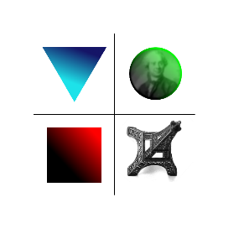
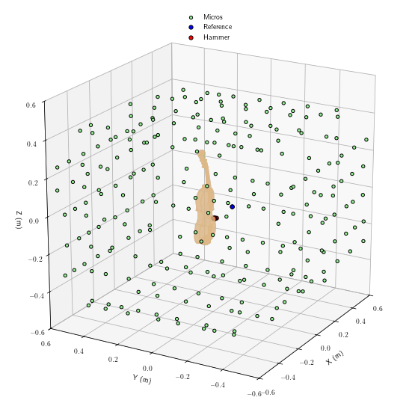
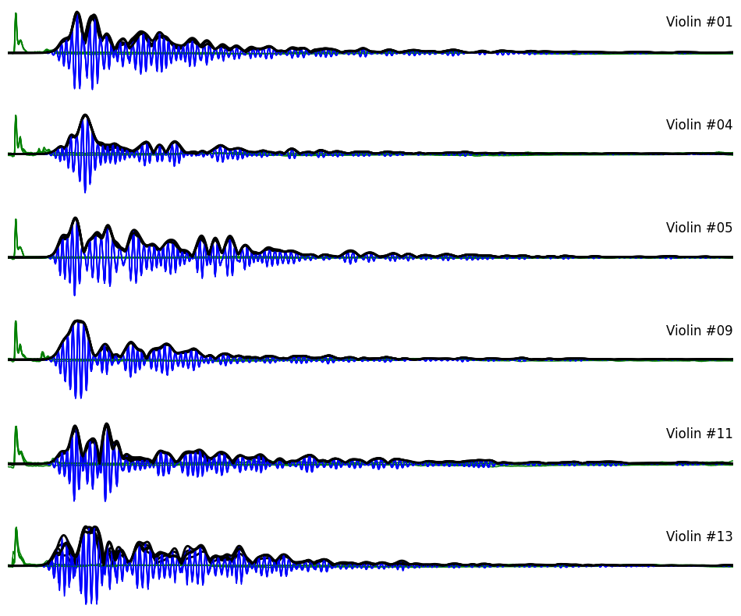
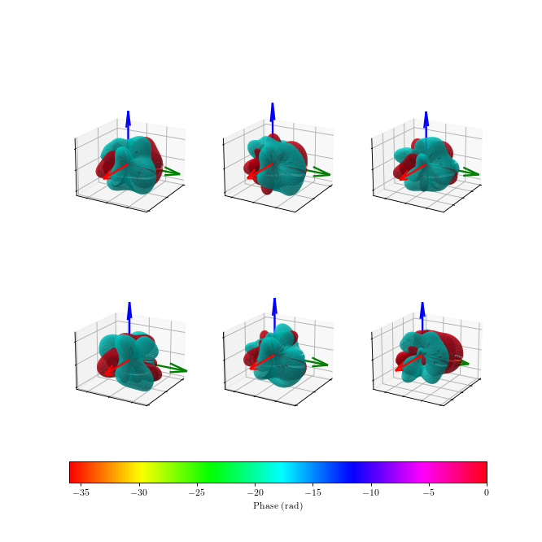
Comparative analysis of the 3D impulse directivity of a batch of six violins
François Ollivier, Matthieu Hartenstein, Augustin Sokpoli, Sebastian Gonzalez, Claudia Fritz
Institut Jean Le Rond d’Alembert Sorbonne Université - CNRS – UMR 7190

Slide 2
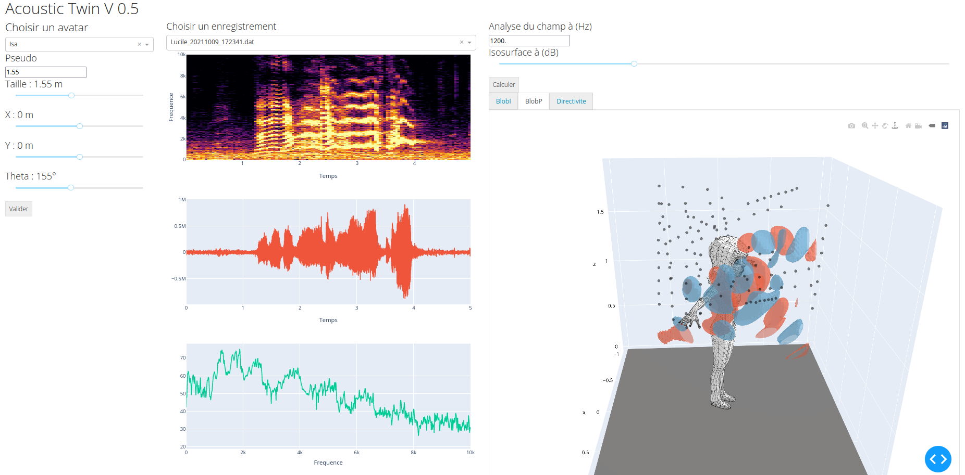
The Bilbao project
Objective : Demonstrate the relationship between mechanical behaviour and tonal quality of the violin.
The RayoVox project (ANR)
Objective : Develop an instrumentation to measure
with high resolution
in the near and far field
The 3D directivity of the voice

Slide 3
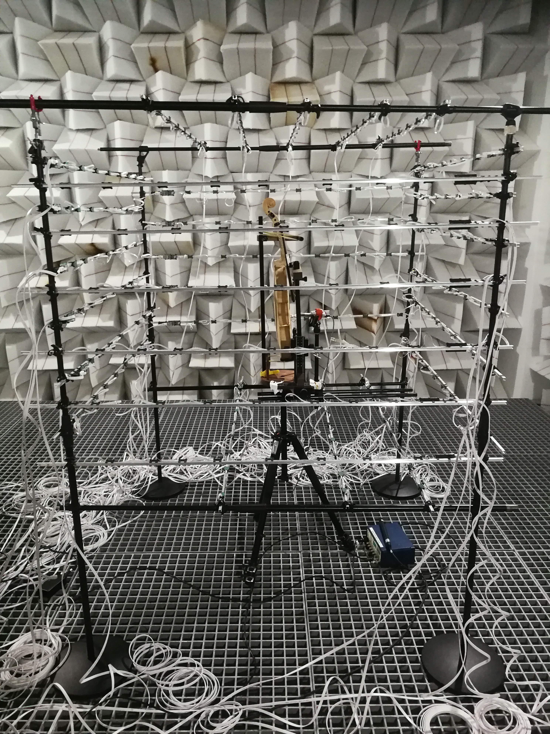
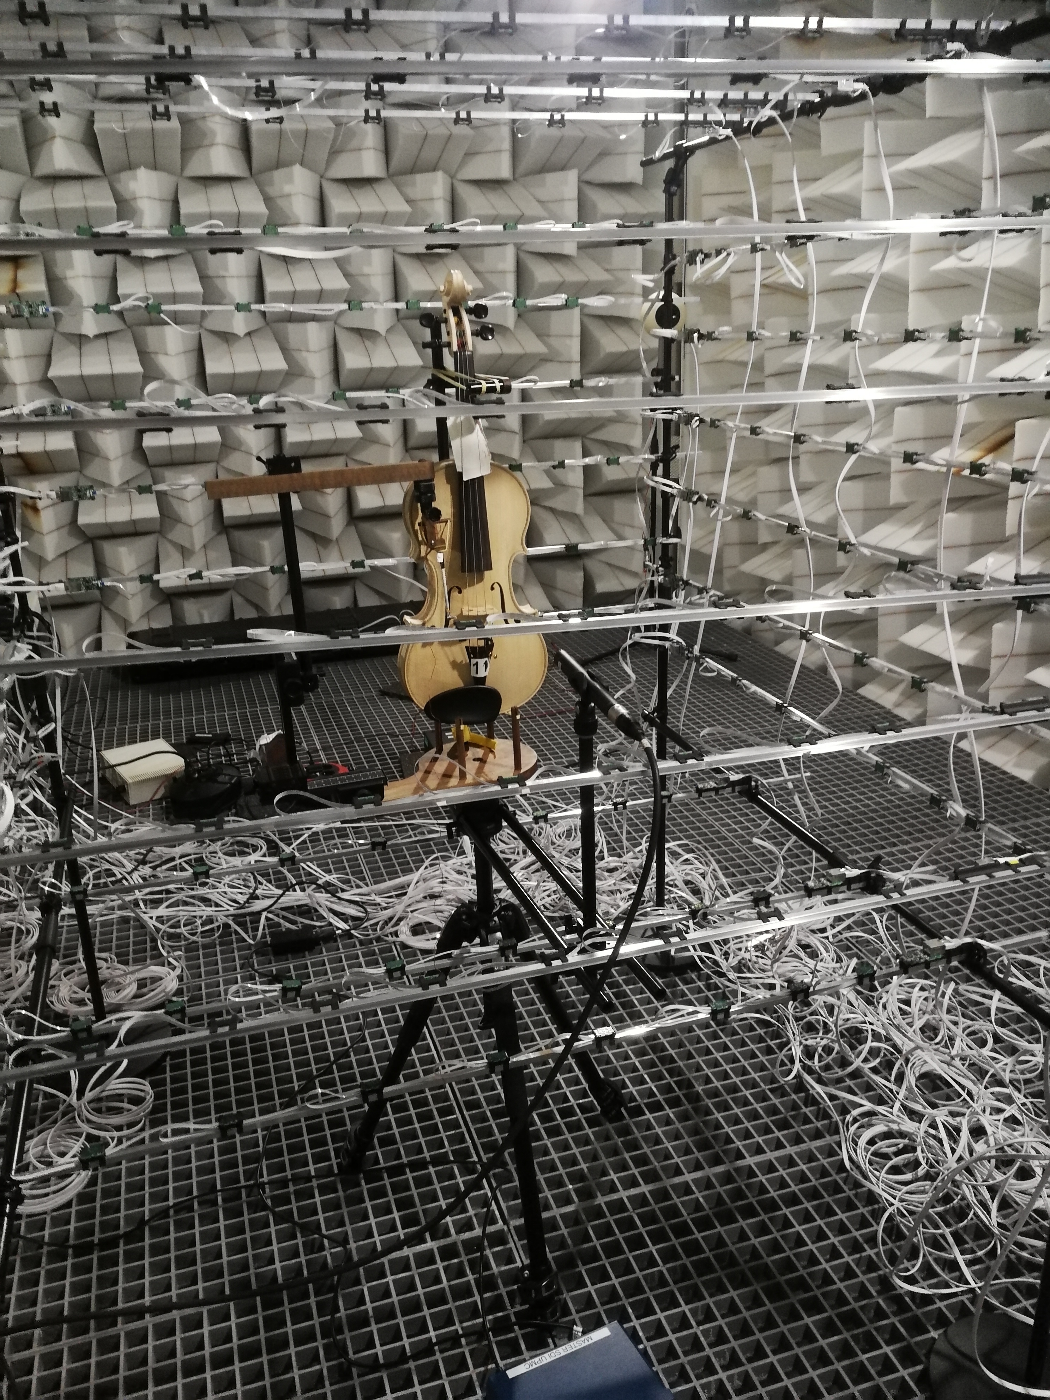
Measurement Setup
A 1m³ Mems microphone array
256 elements arbitrary set on the faces
2 reference microphones
1 impact hammer

Slide 4
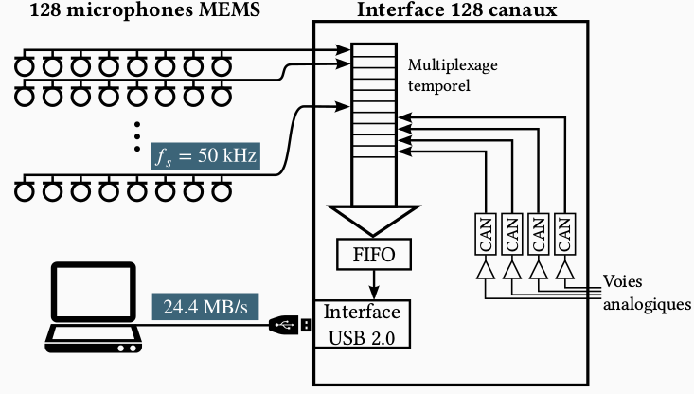
Measurement Setup
A 1m³ Mems microphone array
256 elements arbitrary set on the faces
2 reference microphones
1 impact hammer
Digital recorder Mµ256
I2S digital Mems
Sampling frequency : 50 kHz
Digitization : 24 bits
Control and data transfer : USB3
Data Stream : 51.2 MO/s
Dedicated python library

Slide 5
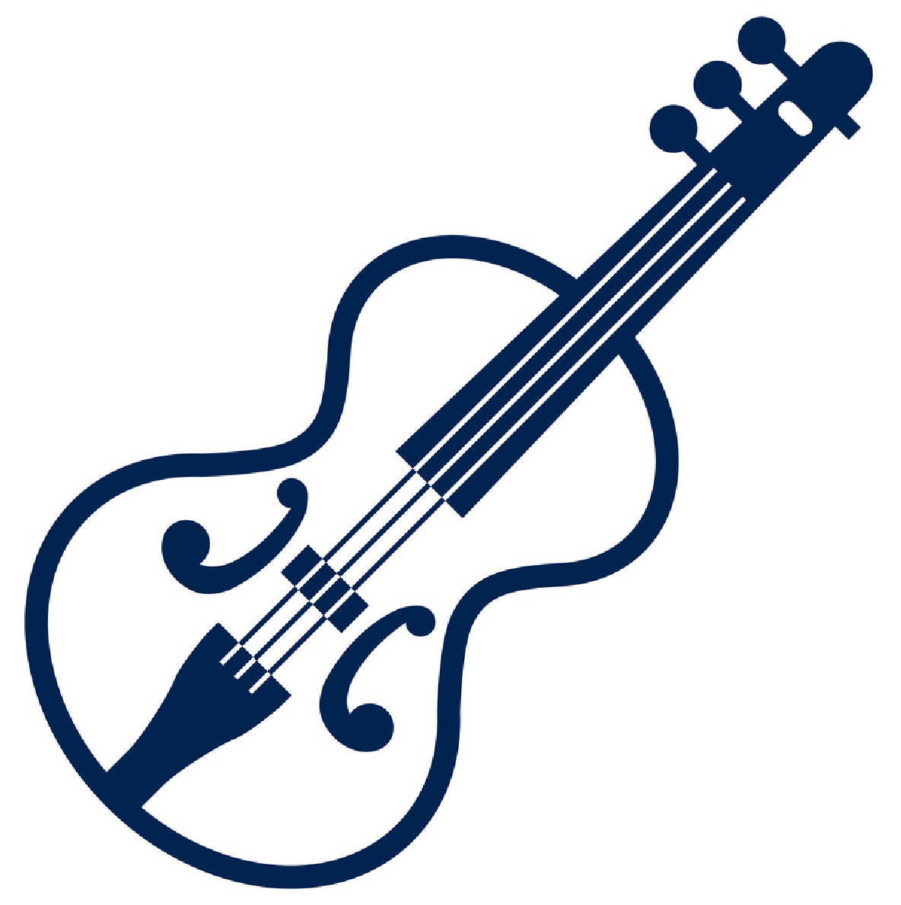

The linear SIMO system under study
Objective : Measure with high resolution D∞(Ω) the 3D directivity of the violins
Measured data :
The hammer impact f(t)
256 acoustic responses mi(t) (i = 1,…,256)
i = (ri , Ωi) = ri
A set of arbitrary points
around the violin
Unknowns of the violin
The vibration FRF
Hfv(rs, ω)
The vibroacoustic FRF
Hvp(rs, ri, ω)
What we need is what we get
The acoustic response to a unitary force at the base of the bridge :
Hfp(rs, ri, ω) = Hfv(rs, ω)Hvp(rs, ri, ω)

Slide 6
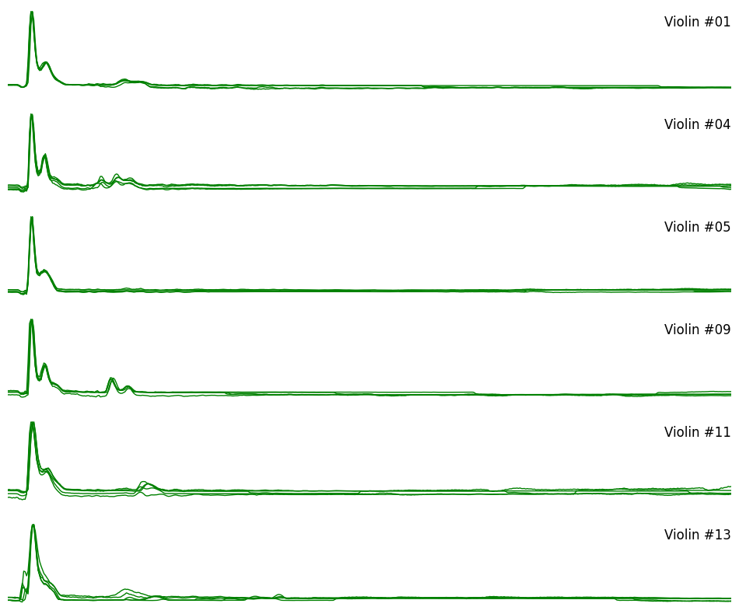
Bouncing Hammer impacts

Slide 7
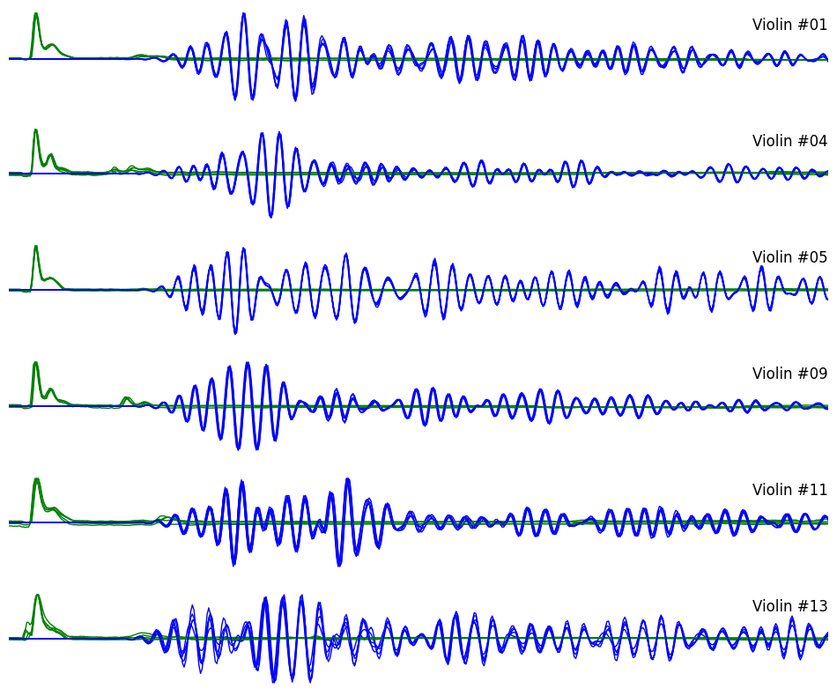
Reference Responses to bouncing Hammer impacts

Slide 8
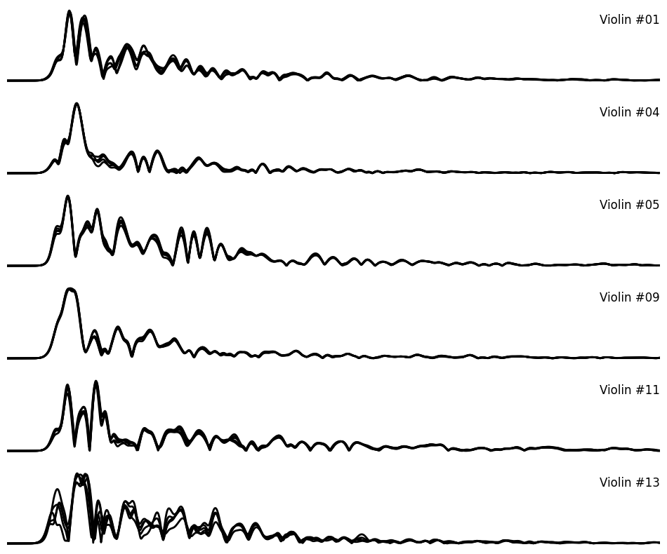
Reference Responses envelopes

Slide 9
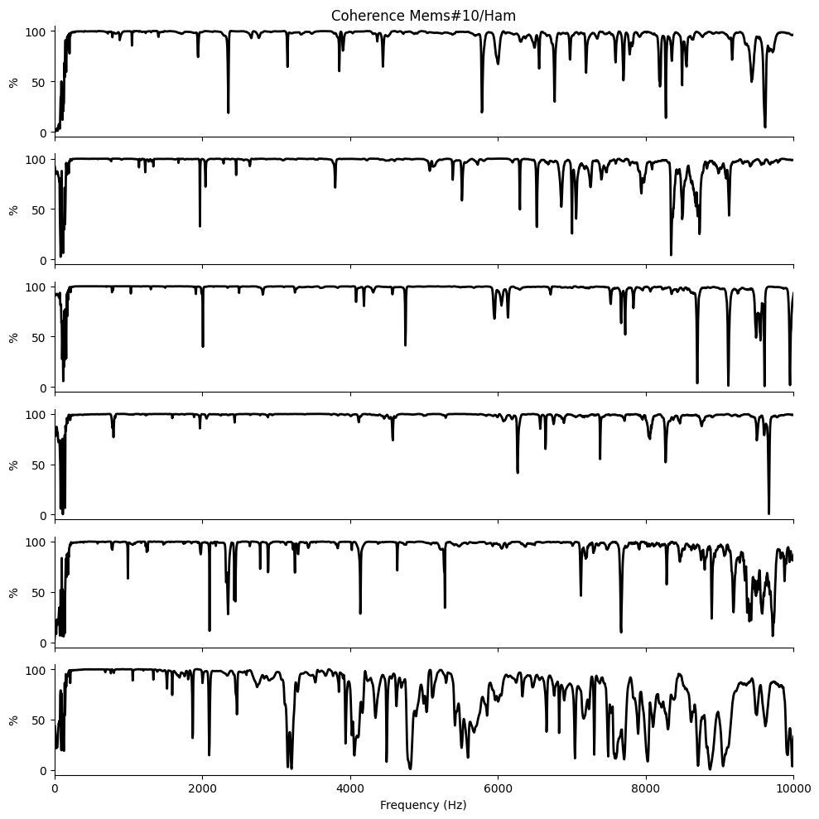
Coherence of 5 impacts for each violin

Slide 10
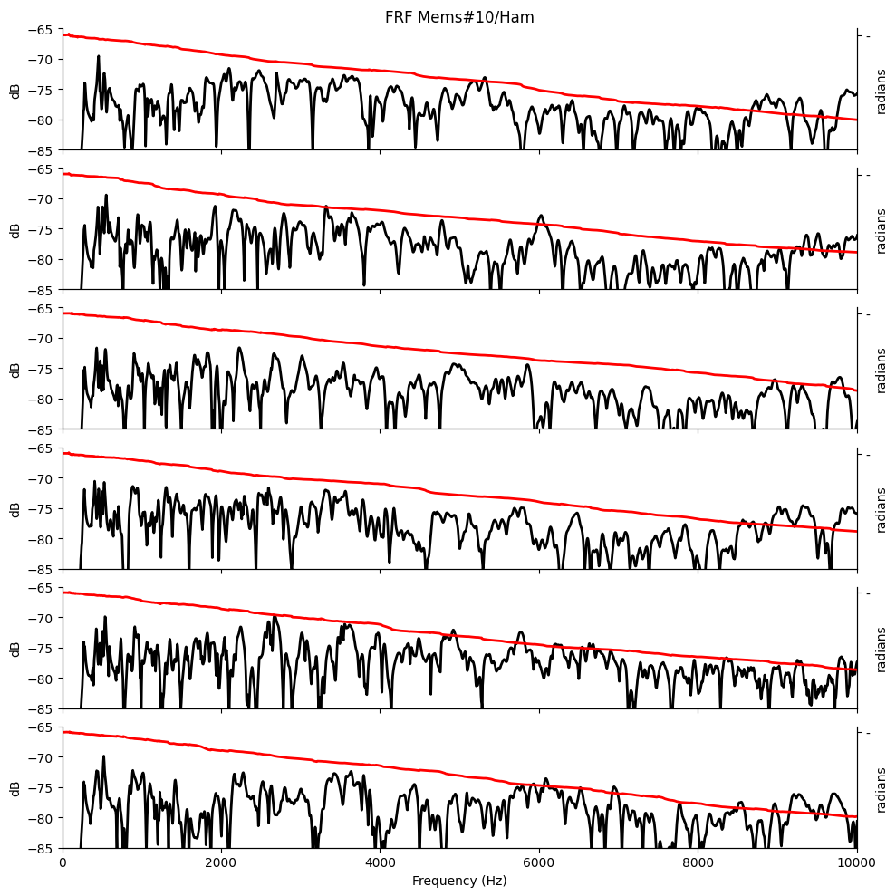
Frequency response functions

Slide 11
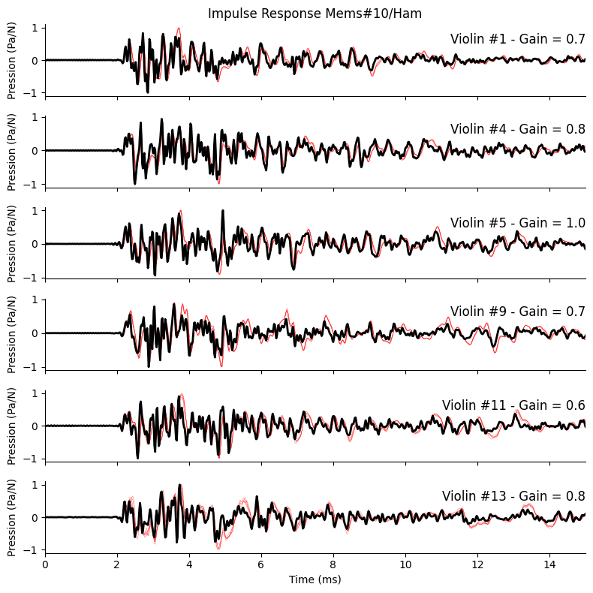
Impulse Response functions

Slide 12
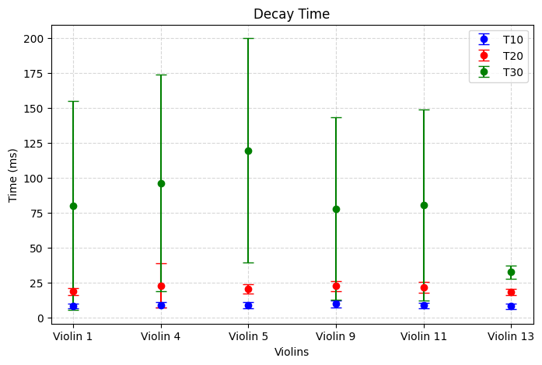
Analyzing the RI enveloppes

Slide 13
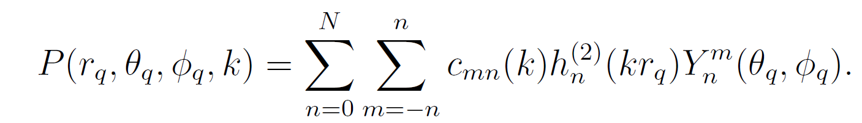
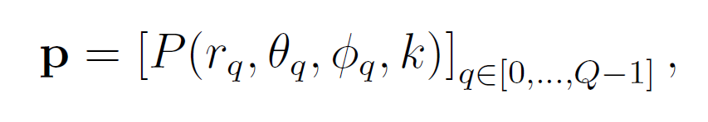
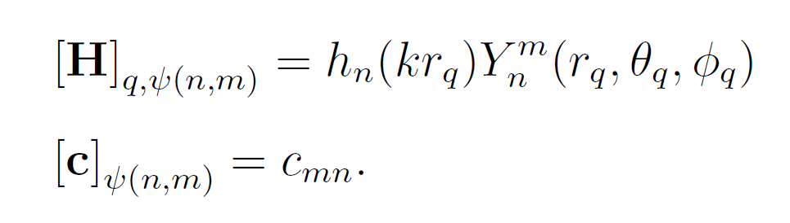
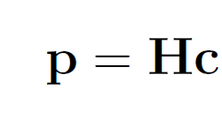
Processing the directivity : The HELS method

Slide 14
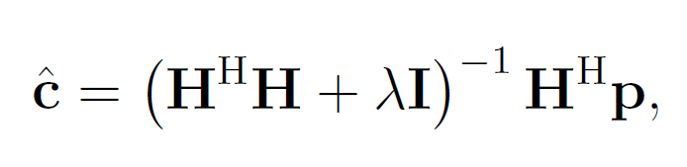
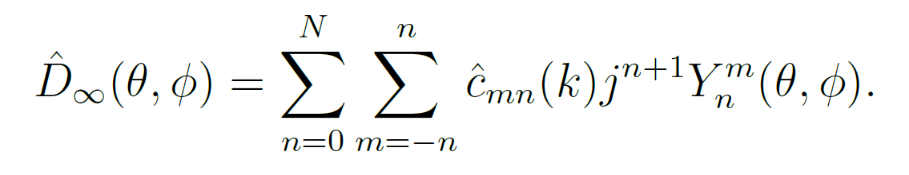
Processing the directivity : The HELS method

Slide 15
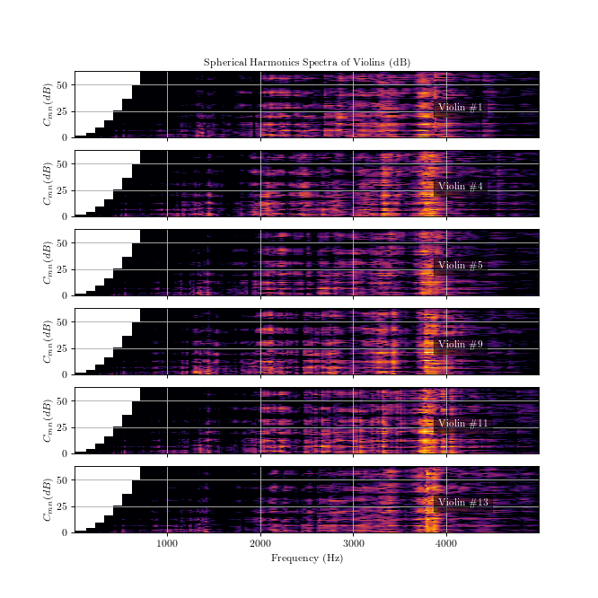
Spherical Harmonics Spectra

Slide 16
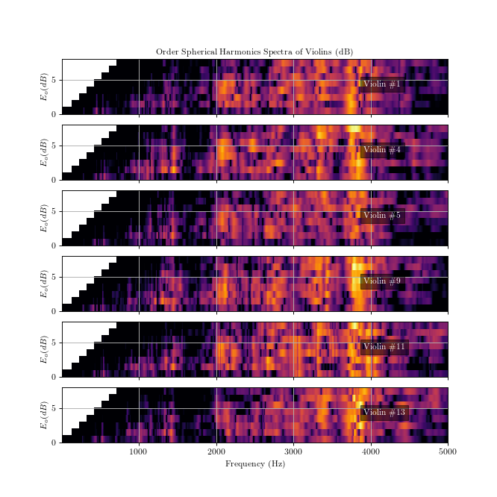
Spherical Harmonics Spectra

Slide 17
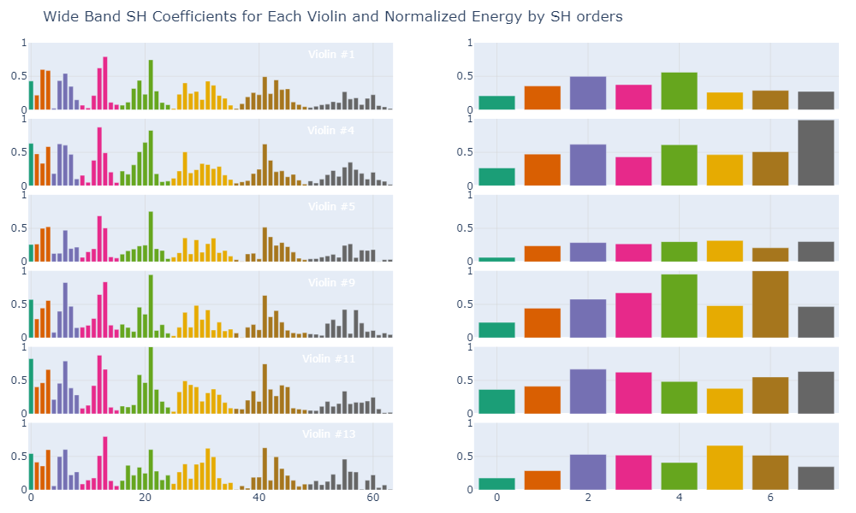
Wide Band Spherical Harmonics Spectra

Slide 18

Wide Band 3D far field directivity (3D-FFD)

Slide 19
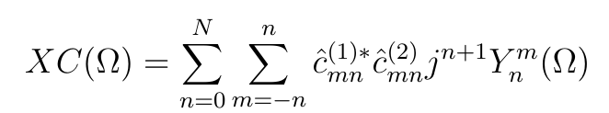
Track the similarities of the FFDs :
The spherical cross-correlation
Leverage the spherical correlation to estimate :
The level of similarities between 2 FFDs
The directions of the similarities

Slide 20
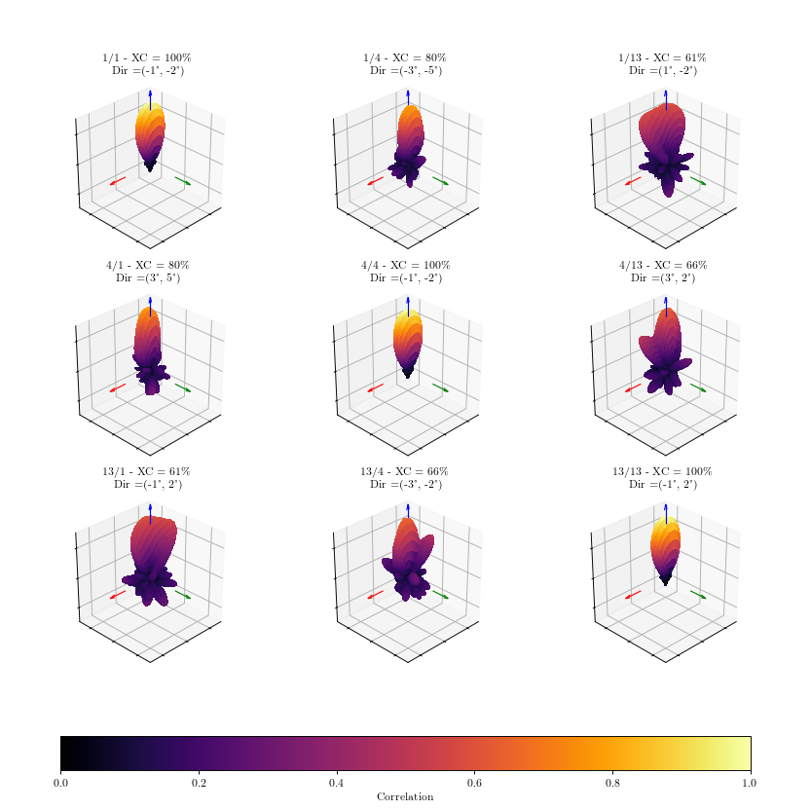
Track the similarities of the FFDs :

Slide 21
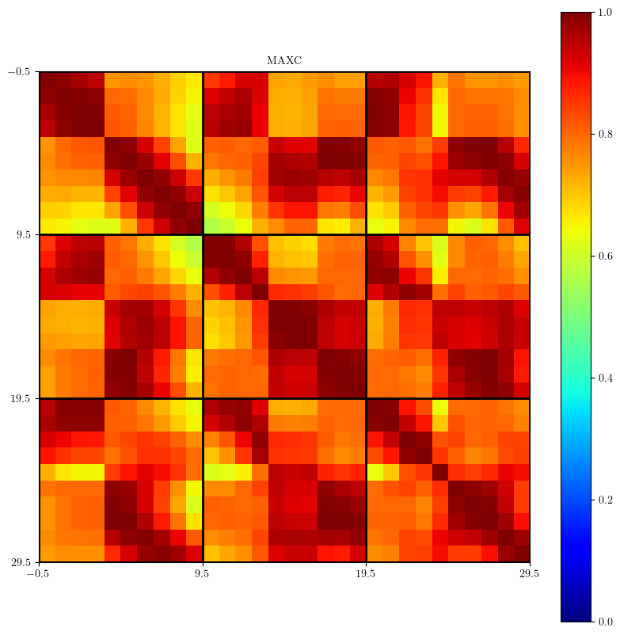
Track the similarities of the FFDs :
Considering the frequency dimension

Slide 22
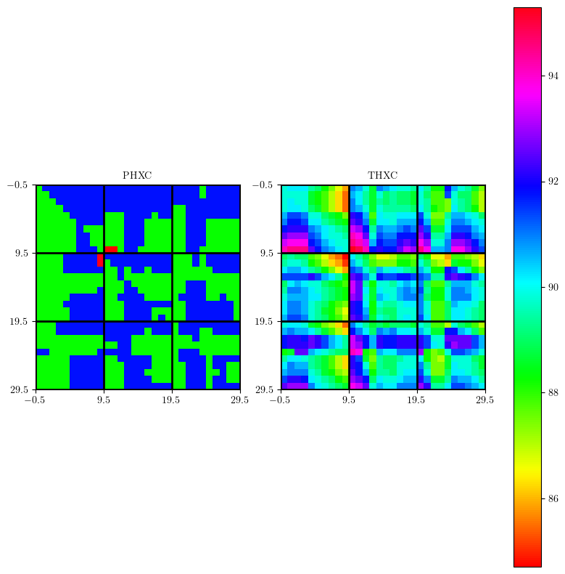
Track the similarities of the FFDs :
Considering the frequency dimension

